Slide 1
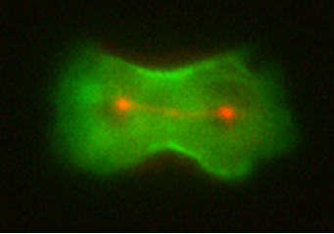
Build a Story, Make it Interesting:
Effective Science Communication
Douglas Robinson
Departments of Cell Biology, Medicine,
Pharmacology and Molecular Sciences,
Chemical and Biomolecular Engineering
Johns Hopkins University
School of Medicine

Slide 2

Major Goals
Overall: Learn how to convey your science clearly
Art of Slide Making
The Use of Analogy
Market Analysis

Slide 3
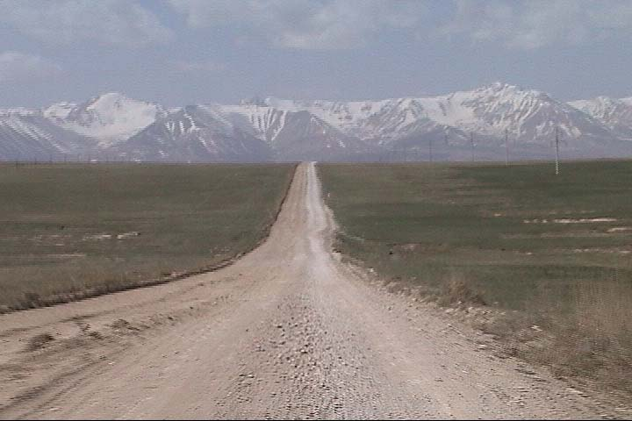
Building a Story, Make it Interesting
In the beginning, tell me where we are going
Take me on
a journey
Tell me when and where we have arrived
Give me a vision of where
we are off to next

Slide 4

Art of Slide Making: Branding
Brand your slides with a trace of color
Then, color becomes optional in the rest of your slide

Slide 5

Art of Slide Making: How many ideas per slide?
Generally just one or two points, ideas or concepts per slide
For more than one, you should use animation
to have them appear one at a time

Slide 6
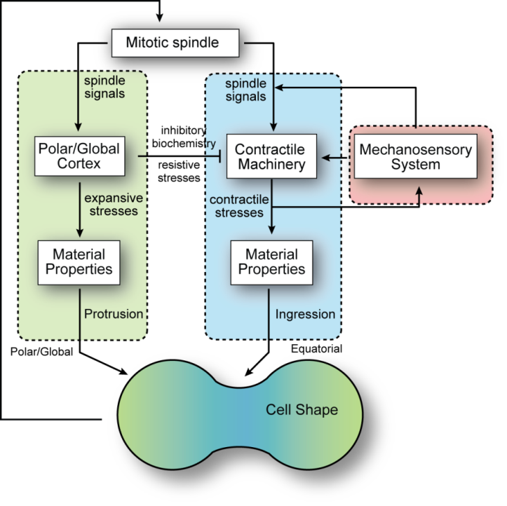
Art of Slide Making: White Space is Free
Why would I do this?
Kee, 2012; Mohan, 2012;
West-Foyle, 2012; Srivastava 2015

Slide 7

Art of Slide Making: White Space is Free
When I can do this?
Kee, 2012; Mohan, 2012;
West-Foyle, 2012; Srivastava 2015

Slide 8
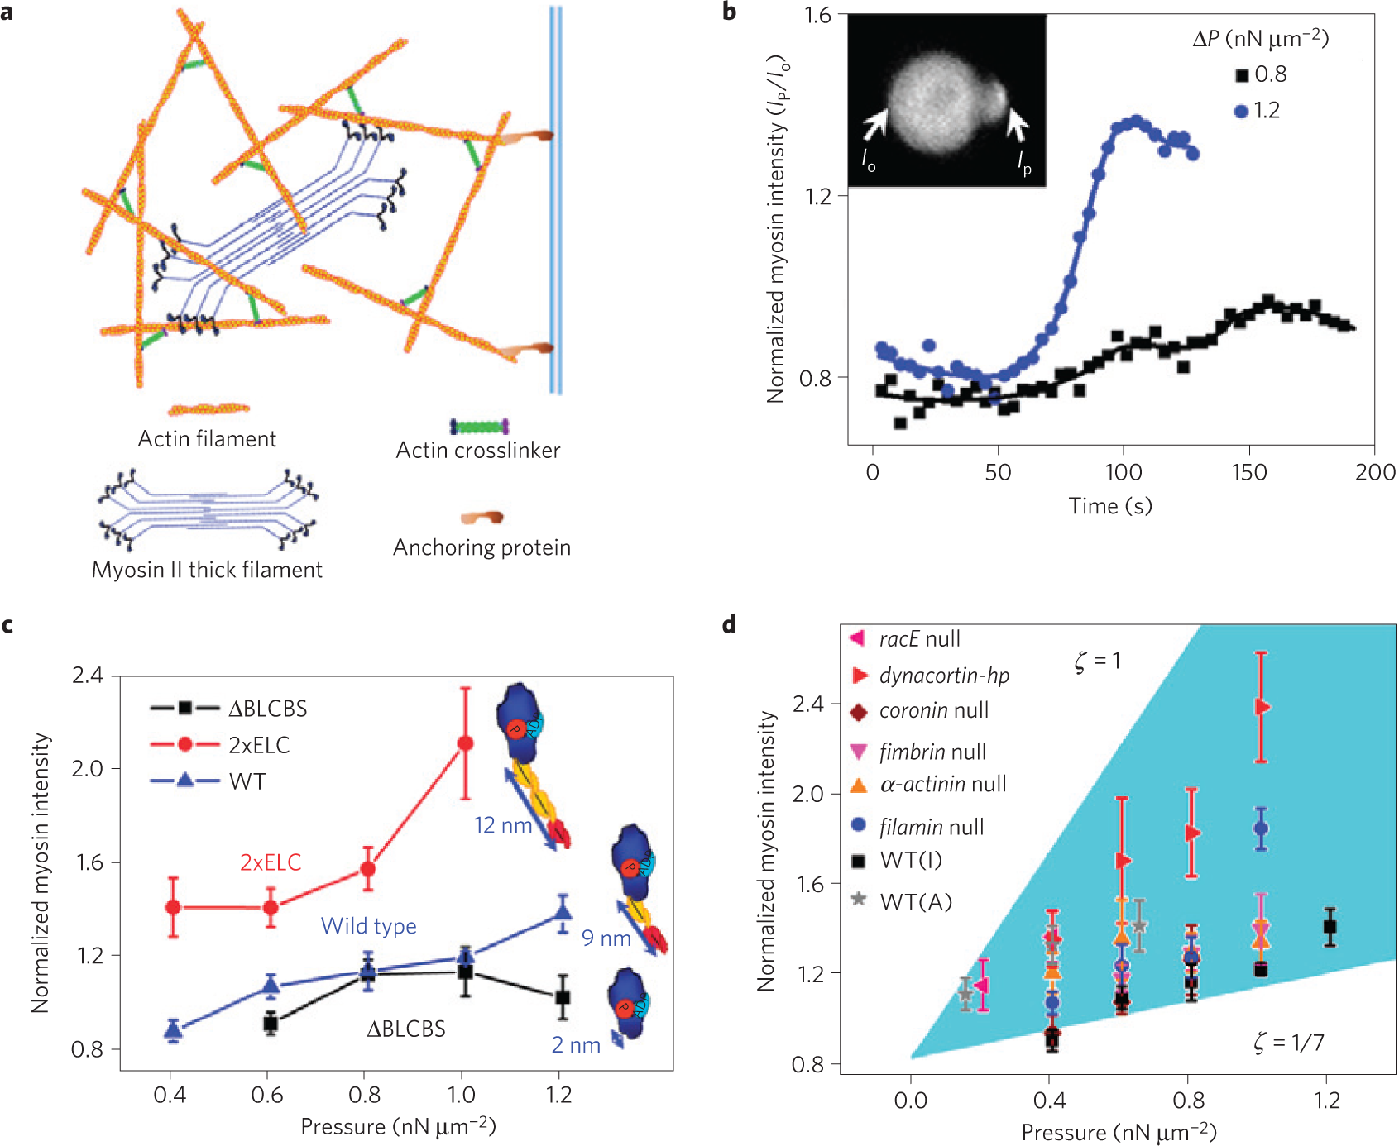
Art of Slide Making: Paper Figures are not Slides

Slide 9
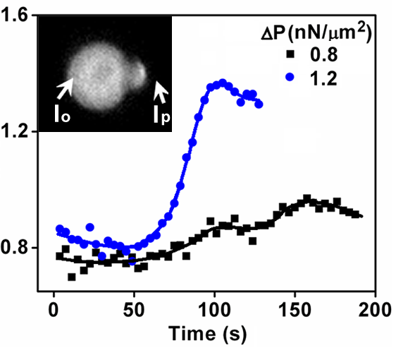
Art of Slide Making: Build your Slides
Normalized Myosin II Intensity (I_{p}/I_{o})

Slide 10
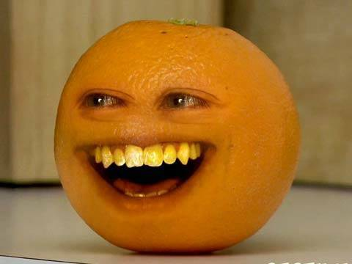
Art of Slide Making: Animations
Use appear only
This is annoying
This is distracting
This is disturbing

Slide 11
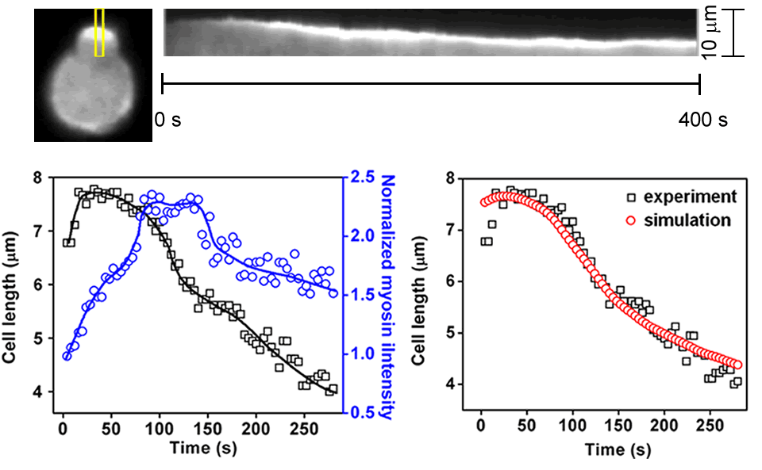
Art of Slide Making: Purposeful Use of Animations
Luo et al. Nat. Mater. 2013

Slide 12
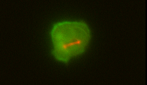
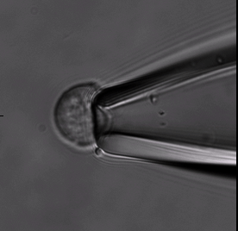
Art of Slide Making: Videos
Videos are excellent, but please play just one at a time
Please do not do this

Slide 13

Art of Slide Making: Text
Titles: 28 pt
Subtitles: 24 point
Axis Labels 20 point
Nothing smaller, please
Please use a Sans-Serif Font
Arial or Helvetica work well
Standardize across slides

Slide 14
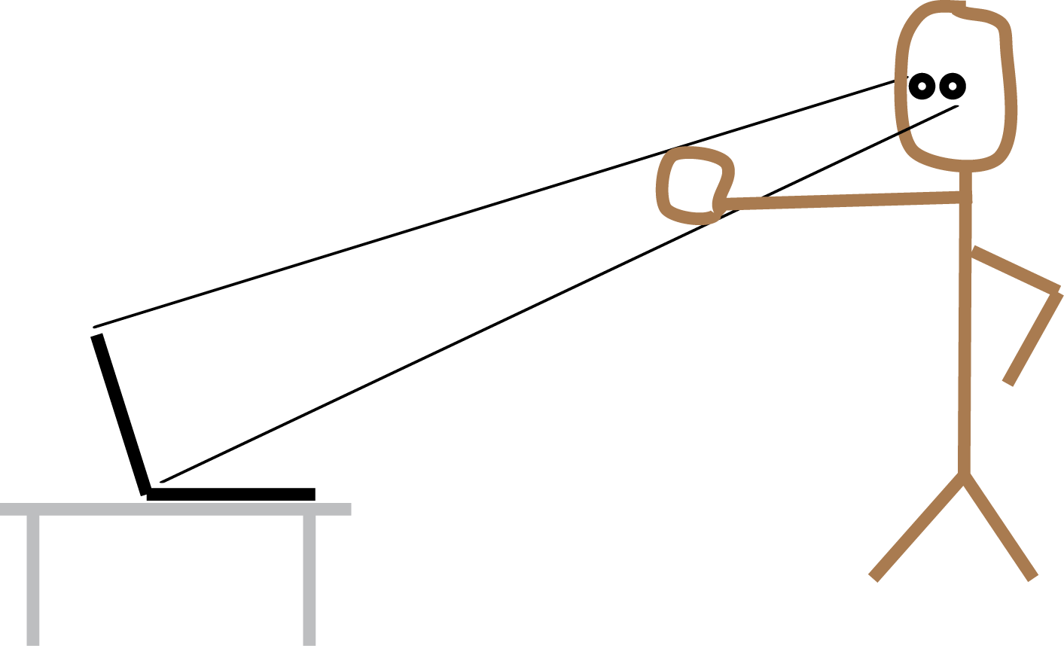
Art of Slide Making: The Fist Metric
Sit back from your computer
Cover the screen with your fist
Lower your fist
Can you read it? If yes, you are okay
If not, your audience won’t be able to either

Slide 15
Art of Slide Making: Text
To my eye, black text on a white background looks the best, and the light balances the room

Slide 16
White on black is not bad, but the black backgrounds can really darken the room
The difference is largely about personal taste

Slide 17
Is there really anything uglier than this?
Well, yes there is!
And it can get even worse.
See how the serifs blur the letters.

Slide 18
Art of Slide Making: Text
Please use minimal text
Rule of thumb: No more than two lines in a bullet point
Otherwise, if you have more than two lines, the text gets really cumbersome and hard to read and your audience spends time reading instead of listening to you, which makes it much harder for you to get your point across. See what I mean.

Slide 19
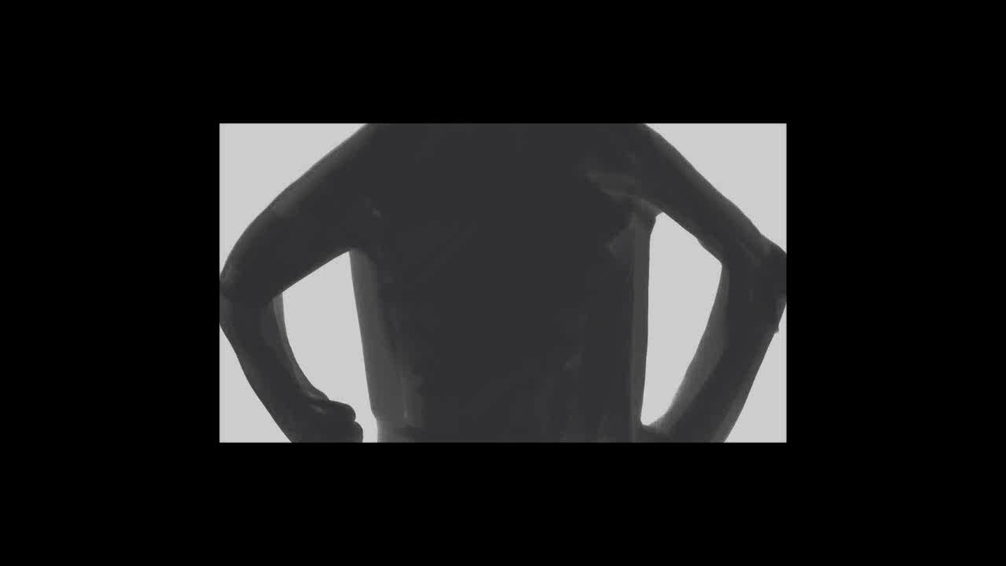
Analogies make the story come alive and help communicate challenging concepts
Imagine you are a builder…..

Slide 20
Analogies make the story come alive and help communicate challenging concepts
A dividing cell is just like this….

Slide 21
Note on Rigor and Reproducibility
Avoid featureless, uninformative bar graphs
Depict your data in a manner that reveals sampling, distribution shapes, and appropriate statistical analysis
p=0.0001
p=0.15
p<0.0001
6
3
p=0.08
4
p=0.03
Mean
2
p=0.43
Value
2
1
45
27
16
0
0
Set 1
Set 2
Set 3
Set 1
Set 2
Set 3
Dataset
Dataset
ANOVA with Fishers LSD
Kruskal Wallis: p=0.039

Slide 22
Building a Story, Make it Interesting:
A 55 minute seminar summarized in four slides…
In the beginning, tell me where we are going
Take me on
a journey
Tell me when and where have arrived
Give me a vision of where
we are off to next

Slide 23
“To see the world in a dividing cell”
Dictyostelium
GFP-myosin II
RFP-tubulin,
queued every 5th frame
Diseases like
Cancer, COPD, Motor Neuron Disease
Tissue Development
and Regeneration
Cell Proliferation

Slide 24

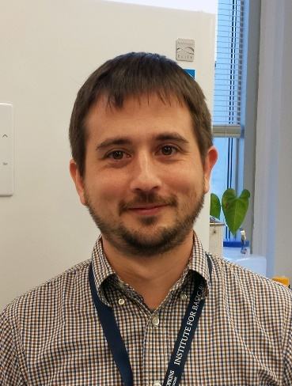
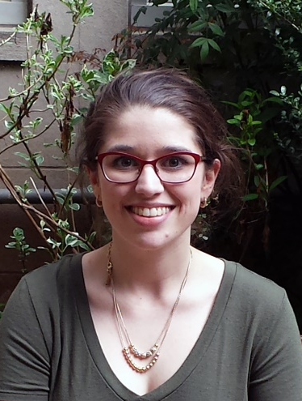
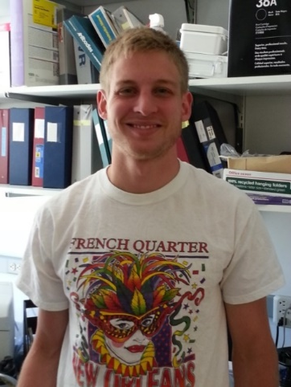
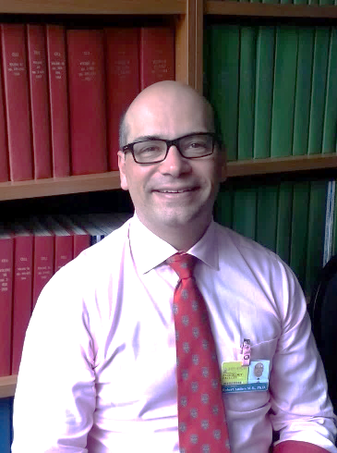
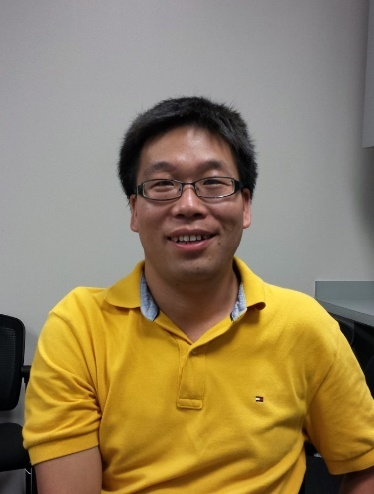
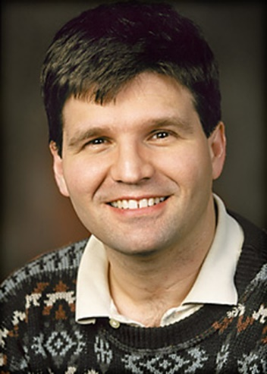
Mechanobiology of metastatic pancreatic cancer
Alexandra Surcel
Research Faculty
Eric Schiffhauer
Doctoral student
Dustin Thomas
Postdoc
Kat DiNapoli
Doctoral student
Bob Anders
Pathology
Charlie Zhu
Pathology
Pablo Iglesias
Elect. Comp. Eng.

Slide 25
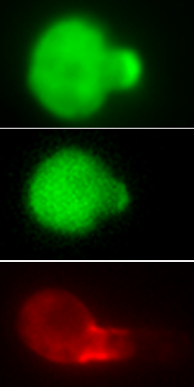
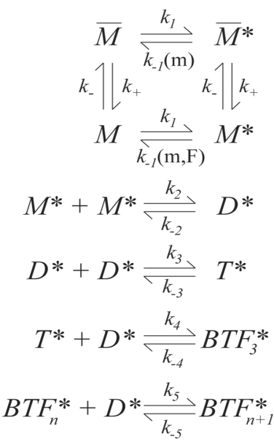
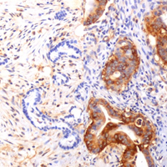

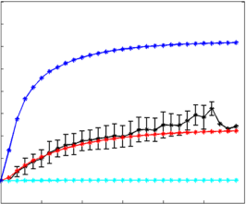

Mechanobiology:
From Fundamentals to Therapeutic Targets
Model System
Human
Experiment
Theory
Prediction
Experiment
PDAC
MyoII
ACTN4
Simulations
ACTN
36 s⁻¹
Intensity
5.2 s⁻¹
0.4 s⁻¹
ACTN1
FIL
0
6
12
Time, s

Slide 26



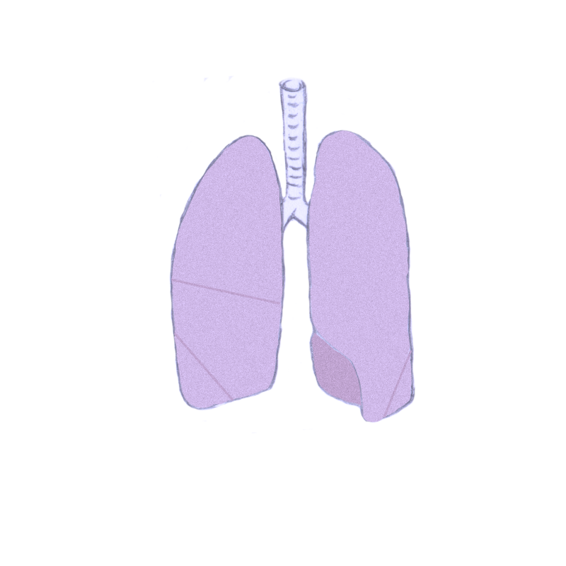
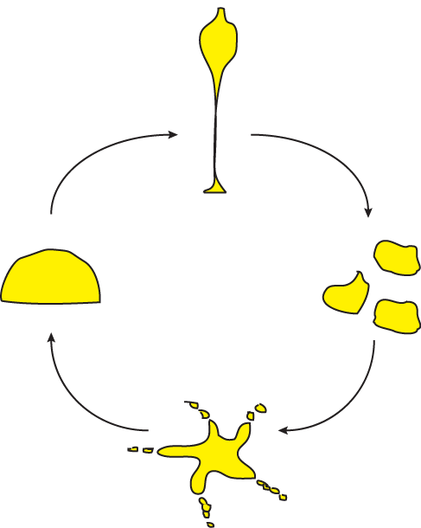

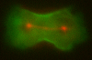
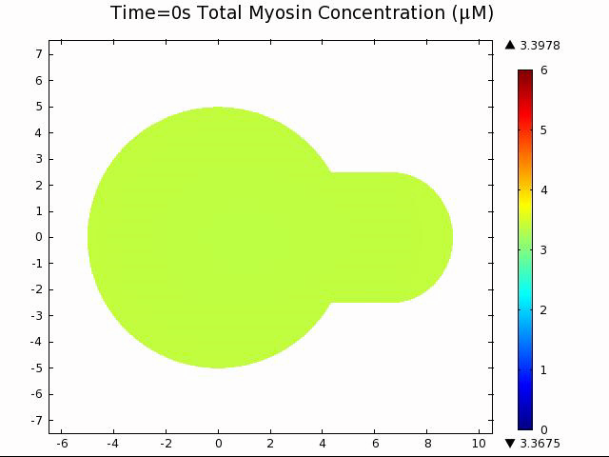
From experimental to computational to chemical biology to human disease
Models
Conceptual Approaches

Slide 27
Preparation and Practice, Practice, Practice
If your audience will invest an hour in you, you can invest an hour/audience member in preparation
Practice your presentation in front of your lab and outside your lab
This is Market Analysis
Would Coca Cola spend $2M on a Super Bowl commercial without testing?

Slide 28
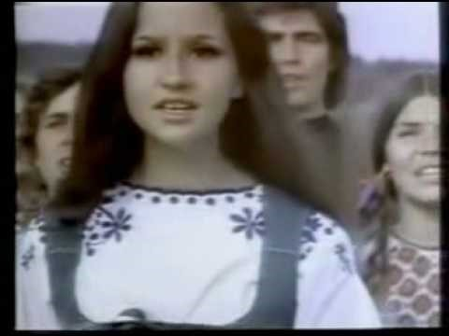
Preparation and Practice, Practice, Practice
https://youtu.be/ib-Qiyklq-Q

Slide 29
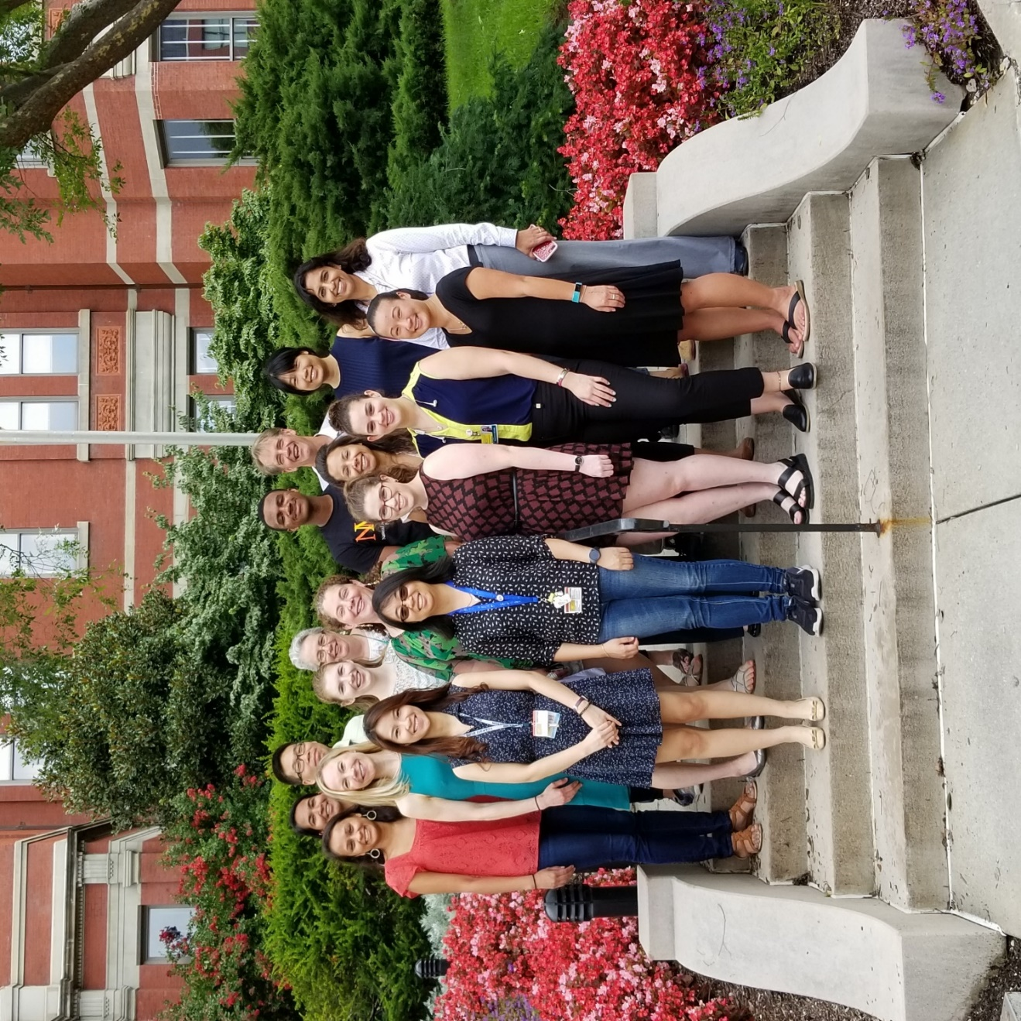
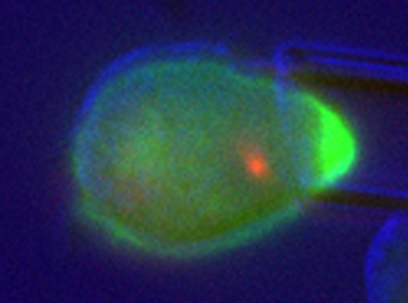
Acknowledgements
Current Members
Shantel Angstadt
Amanda Balaban
Kathleen DiNapoli
Isaiah Griffith
Priyanka Kothari
Yinan Liu
Laura Murphy
Jenny Nguyen
Ly Nguyen
Eleana Parajón
Eric Schiffhauer
Alexandra Surcel
Brian Woolums
Cecilia Johnson
Recent Past
Corrine Kliment
Dustin Thomas
Hoku West-Foyle
Collaborators at JHU
Robert Anders, Charlie Zhu, Pathology
Yun Chen, Sung Hoon Kang, MechE
Steve Claypool, Physiology
Peter Devreotes, Takanari Inoue, Cell Bio
Janice Evans, SPH Biochemistry
Zachary Gagnon, ChemBE
Taekjip Ha, Biophysics
Pablo Iglesias, ECE
Liz Jaffee, Lei Zheng, Oncology
Kostas Konstantopoulos, ChemBE
Scot Kuo, Cell Biology, BME
Caren Freel Myers, Pharm. Mol. Sci.
Tamara O’Connor, Biological Chem.
Ramana Sidhaye, Pulmonary Crit. Care
Tom Lloyd, Charlotte Sumner, Neurology
Collaborators outside JHU
Elizabeth Chen, UT Southwestern
Mike Overholtzer, Sloan Kettering
Ron Rock, U. Chicago
Steve Rosenfeld, Mayo
Jenny Van Eyk, Cedars-Sinai
Ralph Weichselbaum, U. Chicago
Current Support
DARPA, Sol Goldman Foundation, HRSA, JHU, NHLBI, NIGMS, Thomas Wilson Foundation

Slide 30

Good luck and have fun telling your stories!

